Slide 1





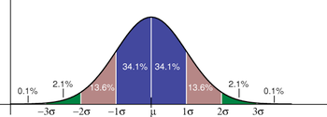
Modelling Covid-19
Agent Based Network &
effects of inhomogeneities
Mathias Heltberg (Paris), Christian Michelsen (NBI), Troels C. Petersen (NBI)

Slide 2
Modified SEIR model
(for reference)

Slide 3
Modified SEIR model
In order to be able to check our model against a reference, and subsequently
quantify the size of effects introduced into the agent based network model,
we build a modified SEIR model (mSEIR) as follows:
β
λE
S
E1
E2
E3
E4
λI
I1
I2
I3
I4
R
The choice of four E and I states is arbitrary and can be changed. Model serves
as reference, to see effects of spatial and infection rate inhomogeneties.

Slide 4
Agent Based Network model
(for exploration of effects)

Slide 5
Agent Based Network
For an Agent Based Network (ABN) model, we choose Ntotal nodes each with
a weight wi and choose an average number of connections, μ.
wi
Ni
dij
Nj
wj
“Rural”
“Urban”
We choose two random nodes (i,j) with probability proportional to wi and wj, and connect over distance dij with probability proportional to p(dij) = exp(-𝝆 dij)

Slide 6
Agent Based Network
For an Agent Based Network (ABN) model, we choose Ntotal nodes each with
a weight wi and choose an average number of connections, μ.
The rate to infect those in our network
is βi = β, matching that of the mSEIR model.
Ni
dij
Nj
wj
“Rural”
“Urban”
We choose two random nodes (i,j) with probability proportional to wi and wj, and connect over distance dij with probability proportional to p(dij) = exp(-𝝆 dij)

Slide 7
Agent Based Network
For an Agent Based Network (ABN) model, we choose Ntotal nodes each with
a weight wi and choose an average number of connections, μ.
The rate to infect those in our network
is βi = β, matching that of the mSEIR model.
Ni
dij
Once infected (E1), the nodes follow the same
path, as in the mSEIR model, just individually.
Nj
wj
“Rural”
“Urban”
We choose two random nodes (i,j) with probability proportional to wi and wj, and connect over distance dij with probability proportional to p(dij) = exp(-𝝆 dij)

Slide 8
Agent Based Network
For an Agent Based Network (ABN) model, we choose Ntotal nodes each with
a weight wi and choose an average number of connections, μ.
The rate to infect those in our network
is βi = β, matching that of the mSEIR model.
Ni
dij
Once infected (E1), the nodes follow the same
path, as in the mSEIR model, just individually.
Nj
To begin with, we choose:
all weights the same (wi = 1), i.e. connection rate homogeneity,
all distance measure the same (𝝆 = 0), i.e. spatial homogeneity.
“Rural”
“Urban”
We choose two random nodes (i,j) with probability proportional to wi and wj, and connect over distance dij with probability proportional to p(dij) = exp(-𝝆 dij)

Slide 9
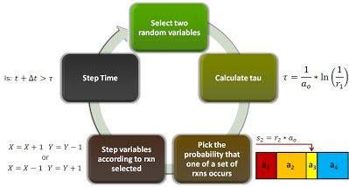
Implementation
The ABN model is implemented as a Doob-Gillespie model, i.e. calculating the
time to the next “event”.
We have managed to run the model for the full Danish population, which takes
25 minutes.
We use housing sales GPS coordinates 2007-2019 [from Boligsiden] as a proxy for
where people live, and distribute the nodes according to a 2D kernel fit to data.
We run several different parameter settings in parallel, and typically repeat the
models simulation 100 times (but “only” for a population of 500.000).

Slide 10
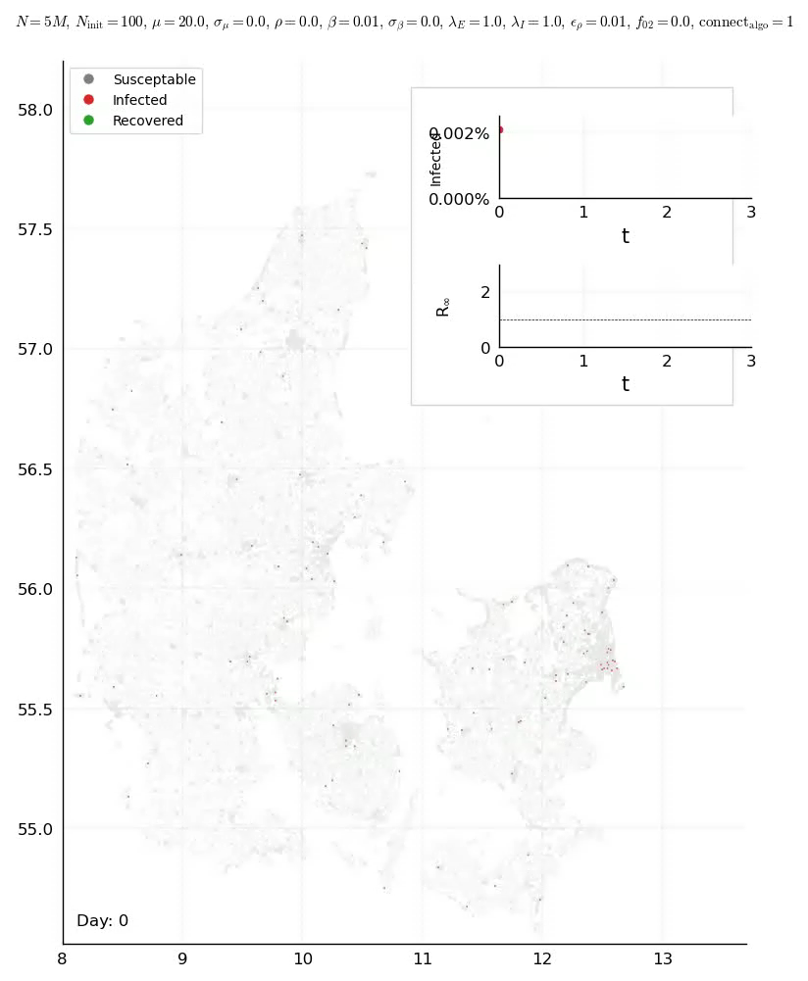
Implementation

Slide 11
Comparison of mSEIR
and basic ABN models

Slide 12
Infection time distribution
As can be seen below, the mSEIR and basic ABN models correspond very well.
The small time delay we believe are due to the continuity of the mSEIR model.
The peak falls 5% below while the integral is the same within 1.5%.

Slide 13
Fluctuations in ABN model
The fluctuations are a result of the number of initially infected (N=100 default).
However, if we start with 1000 infected, they diminish as they should.

Slide 14
Fluctuations in ABN model
The fluctuations are a result of the number of initially infected (N=100 default).
However, if we start with 1000 infected, they diminish as they should.

Slide 15
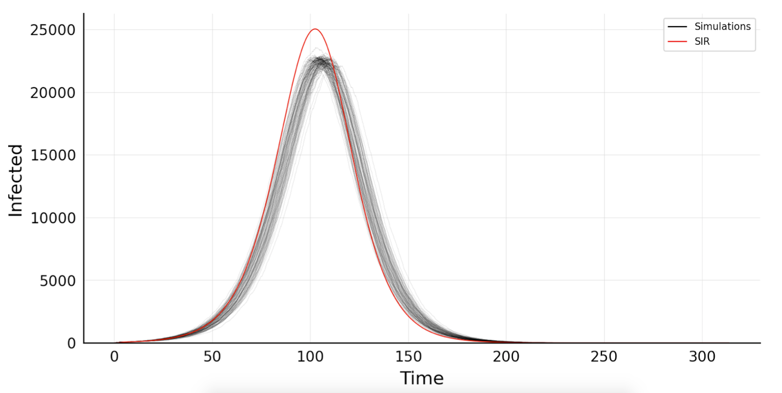
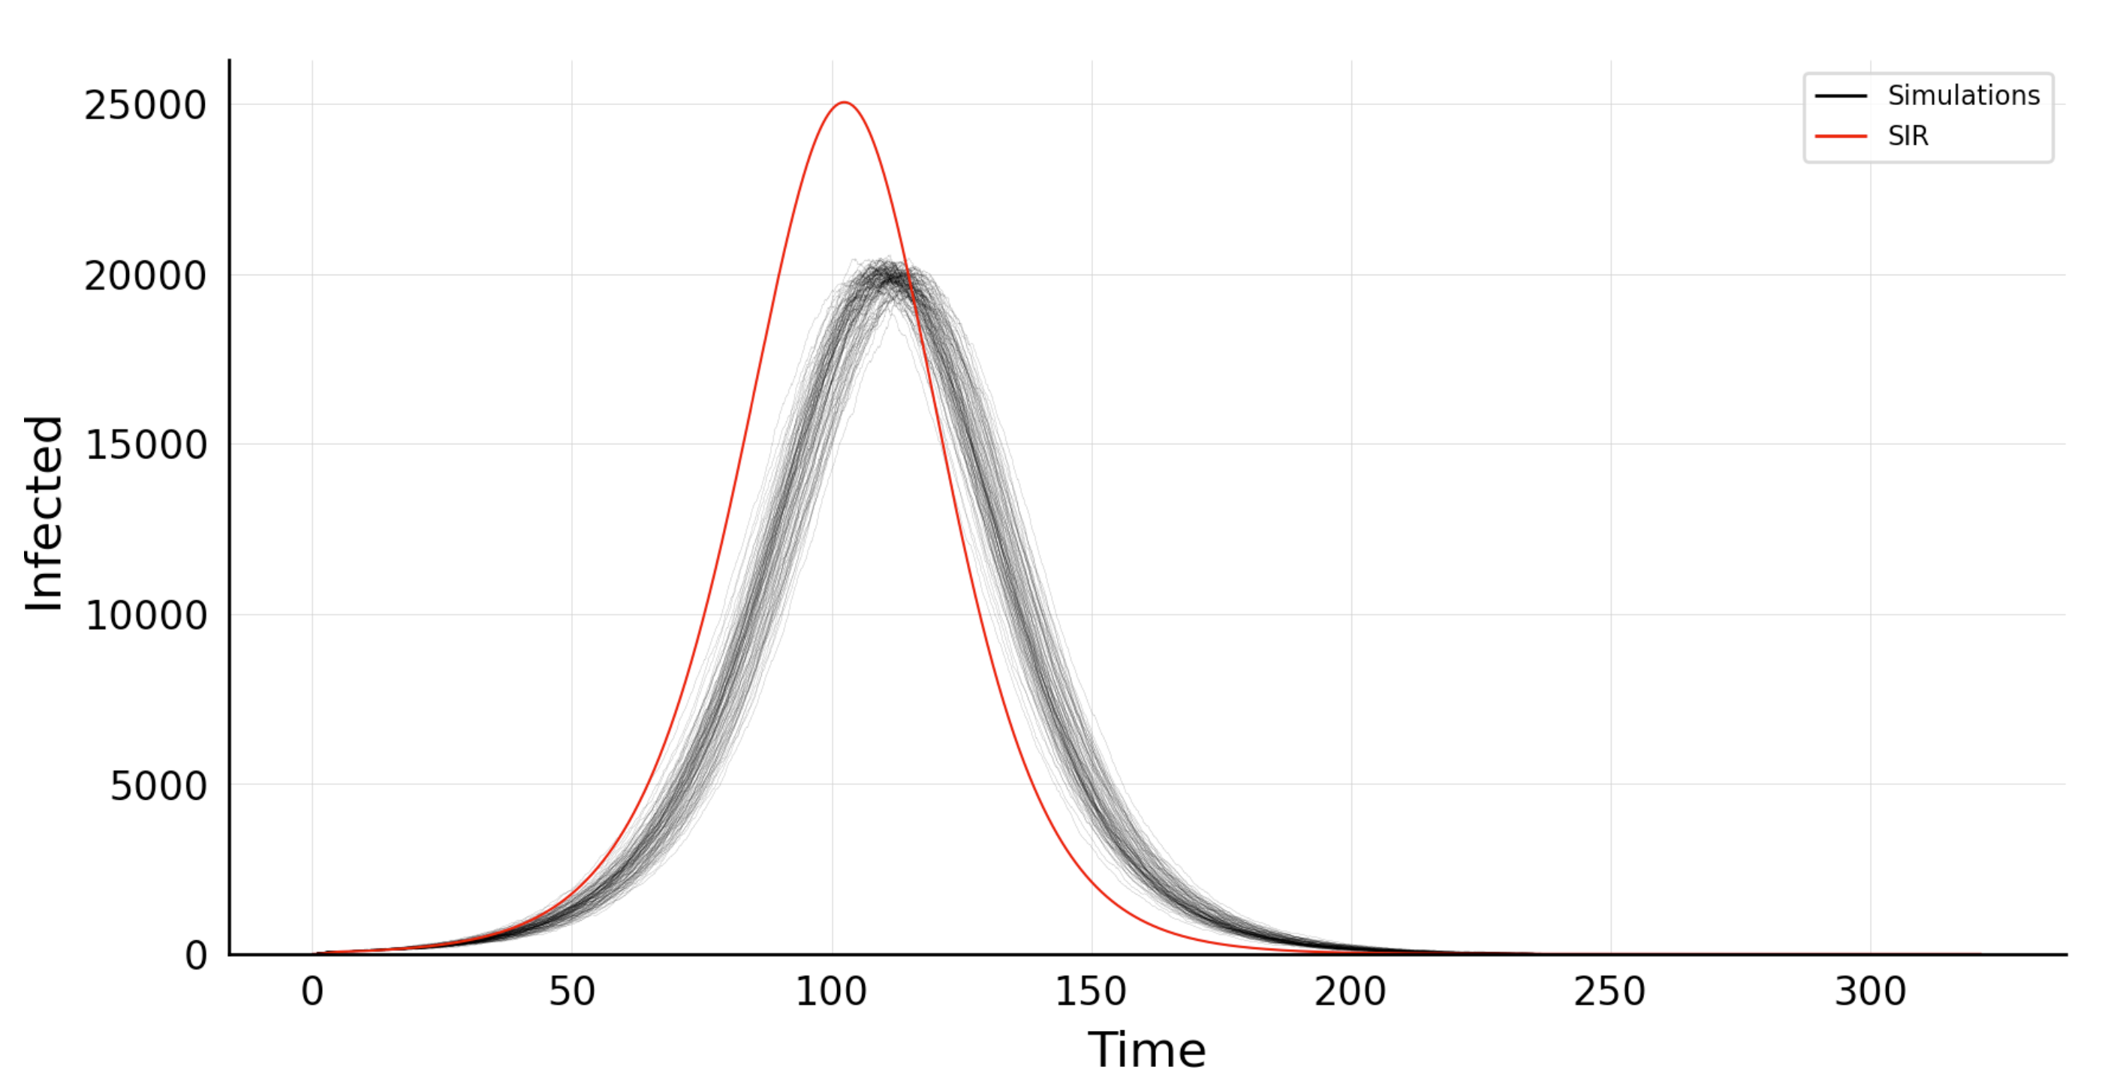
Fluctuations in ABN model
As we keep the theoretical R0 constant, but decreases the mean connections, we get a reduction in the number of infected in the ABN model
μ = 20
β= 0.02
μ = 10
β= 0.04

Slide 16
Introducing inhomogeneties

Slide 17
Exploring effects of
connection and infection inhomogeneties

Slide 18
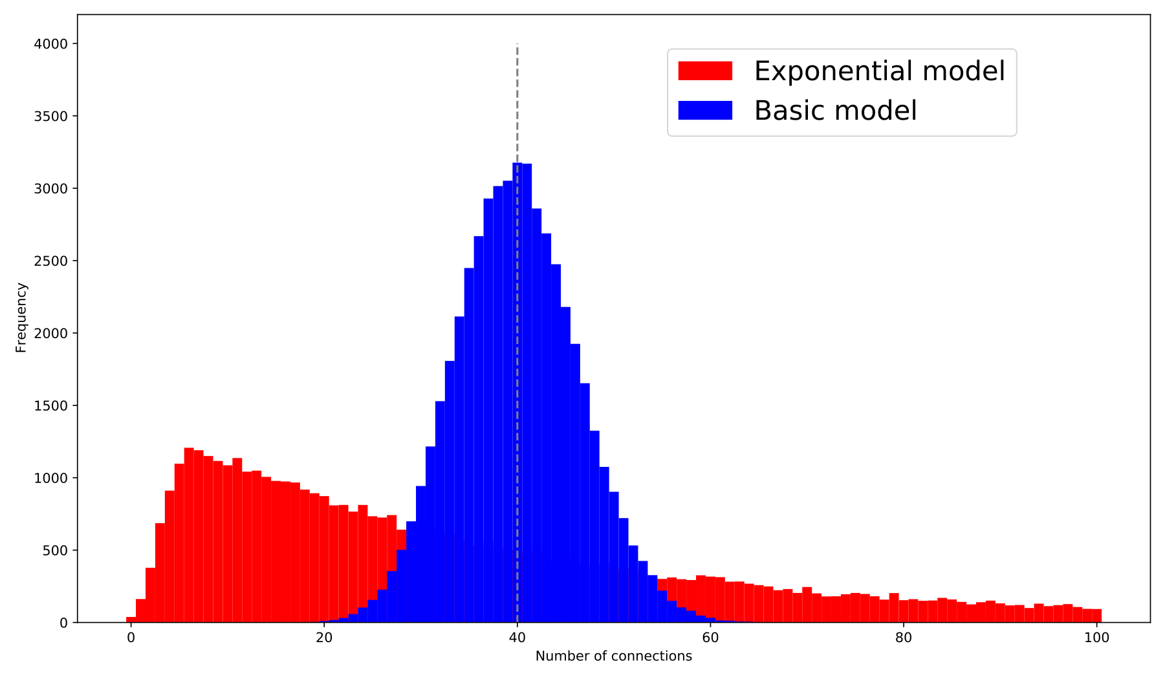
Connection inhomogeneity
First we introduce connection inhomogeneity:
This is done by assigning non-constant weights to each node. Now, there are some nodes, that are more popular/attractive than others.
We have chosen to use shifted exponentially distributed weights, inspired by mobile phone data from the sensible-DTU project.

Slide 19
Connection inhomogeneity
The result of choosing an inhomogeneous number of connections is as follows:
The effect is VERY clear: Super-spreaders (Nconn >> μ) rule the dynamics.

Slide 20
Connection inhomogeneity
Just to see the effect, we interpolate between the two models, and get:

Slide 21
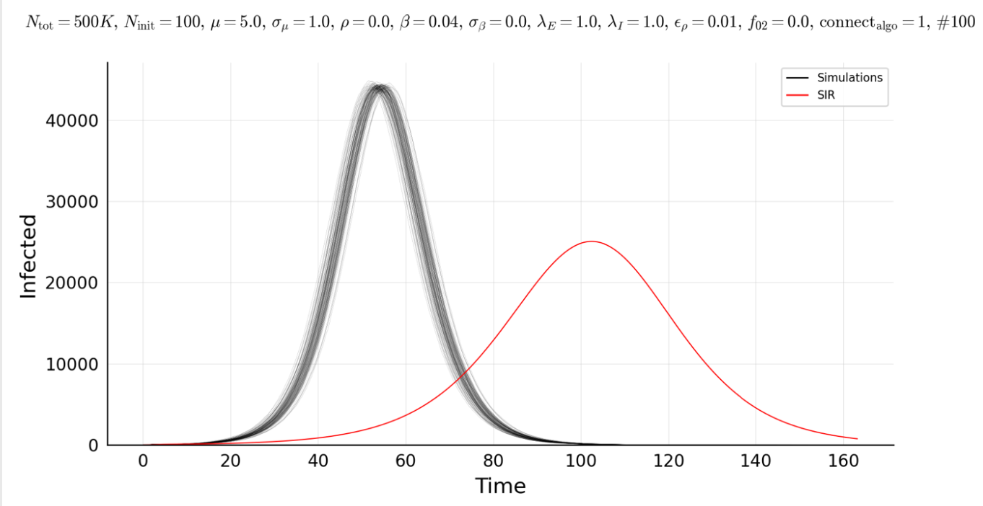
Connection inhomogeneity
Just to see the effect, we interpolate between the two models, and get:

Slide 22
Infection inhomogeneity
In addition, we introduce infection inhomogeneity:
This is done by assigning different infection rates, βi for the infector:
wi
Ni
dij
Nj
wj
“Rural”
“Urban”

Slide 23
Infection inhomogeneity
In addition, we introduce infection inhomogeneity:
This is done by assigning different infection rates, βi for the infector:
wi
Ni
βi
dij
Nj
wj
“Rural”
“Urban”

Slide 24
Infection inhomogeneity
To our mild surprise, there is no effect of this! “Super shedders” play no role!
σβ = 0:
All have the same
value of beta.
σβ = 1:
All have either
double or zero beta.

Slide 25
Exploring effects of
spatial inhomogeneties

Slide 26
Spatial inhomogeneity
Secondly we introduce spatial inhomogeneity:
This is done by choosing a value of 𝝆, which controls the probability
of a connection with distance: p(dij) = exp(-𝝆 dij)
A value of 𝝆 = 10 (0.001 km⁻¹), means that the probability of connecting
falls exponentially with typical distance 1/𝝆 = 100 km.
However, 1% of connections are independent of distance (reflecting
that most know “someone”, who lives “far away”.
We have two models, if two random nodes are not connected:
Only exchange second node: All nodes “similarly” connected
Consider two new nodes: Urbans get much more connected

Slide 27
Spatial inhomogeneties
The result of choosing 𝝆 = 300 (thus 3 km typical connection distance) with
ConnectAlgo1 is:
ConnectAlgo1

Slide 28
Spatial inhomogeneties
The result of choosing 𝝆 = 300 (thus 3 km typical connection distance) with
ConnectAlgo2 is:
ConnectAlgo1
ConnectAlgo2

Slide 29
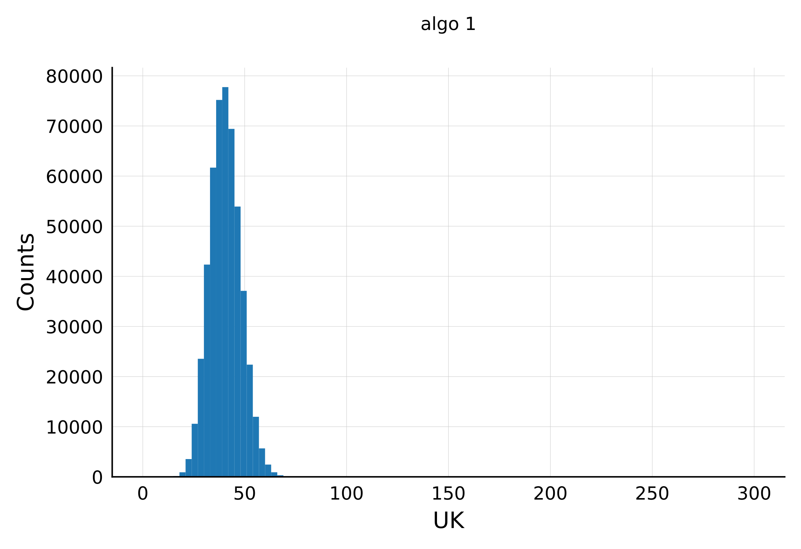
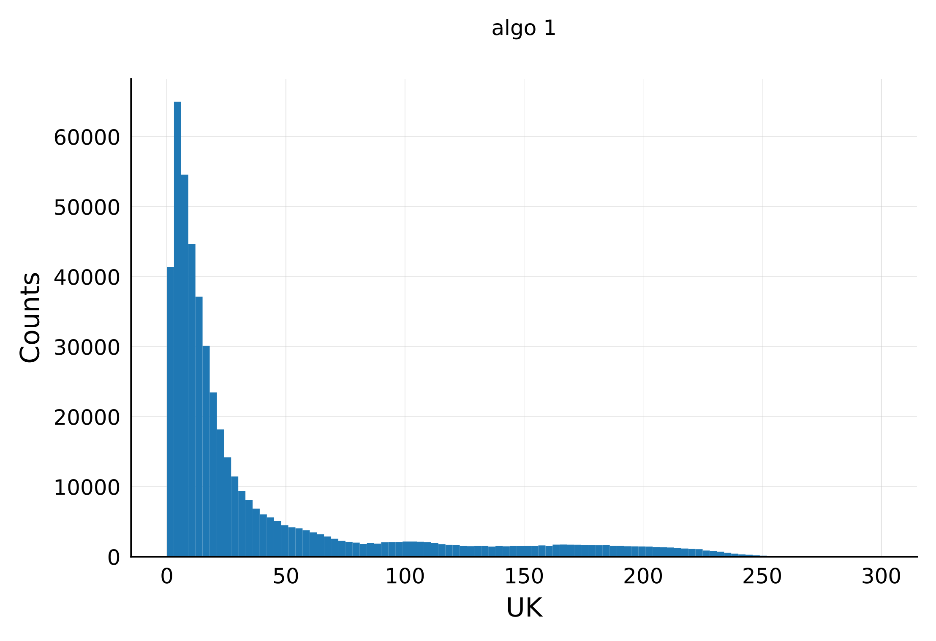
Spatial inhomogeneties
The result as a function of 𝝆 and connection algorithm is interesting:
ConnectAlgo1
ConnectAlgo2
If we insist on connecting rural and urban population “similarly” (ConnectAlgo1),
then we see that the ABN predicts a lower peak than the mSEIR.
If we simply connect people according to distance (ConnectAlgo2), we see a much
larger effect in the opposite direction!
We think that ConnectAlgo2 is more realistic, but not entirely realistic. However,
this algorithm “mixes” the effects of distance and number of connections.

Slide 30
Spatial inhomogeneties
The result as a function of 𝝆 and connection algorithm is interesting:
Note: In BOTH cases, the mSEIR predicts to high an integral!
ConnectAlgo1
ConnectAlgo2
If we insist on connecting rural and urban population “similarly” (ConnectAlgo1),
then we see that the ABN predicts a lower peak than the mSEIR.
If we simply connect people according to distance (ConnectAlgo2), we see a much
larger effect in the opposite direction!
We think that ConnectAlgo2 is more realistic, but not entirely realistic. However,
this algorithm “mixes” the effects of distance and number of connections.

Slide 31
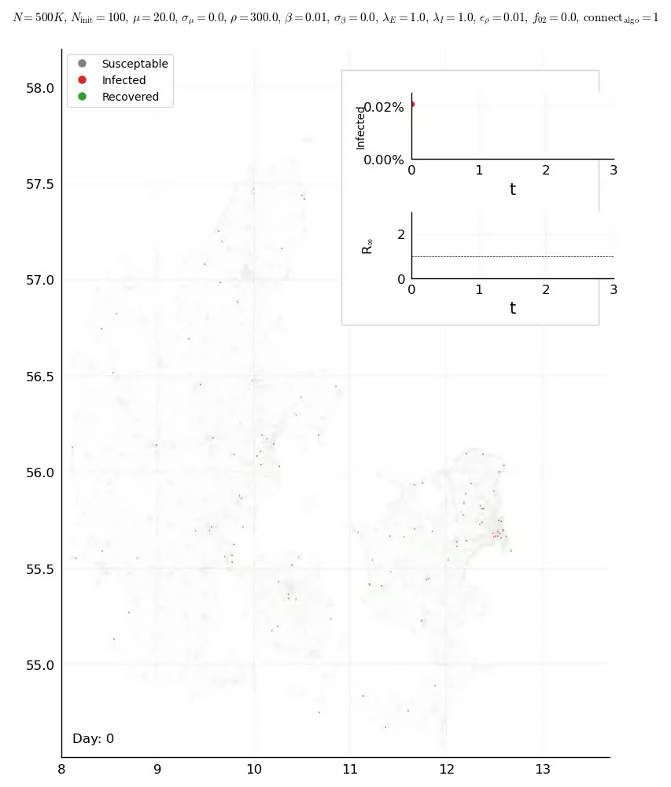
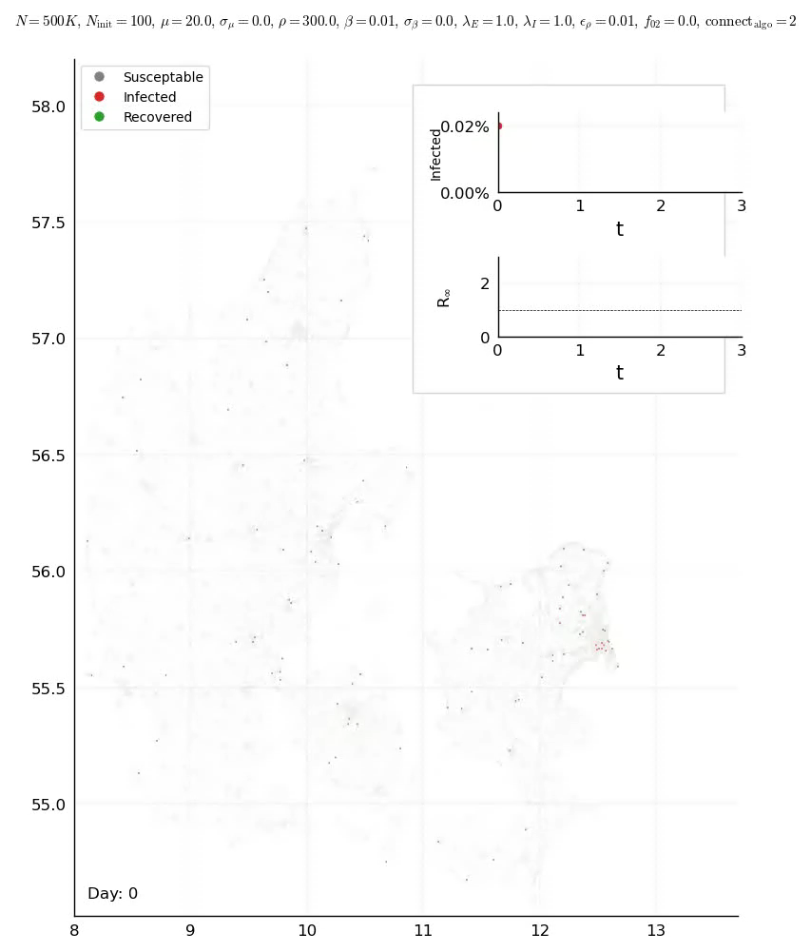
Spatial inhomogeneity visually
The spatial effects are best seen visually, as shown below:
Note: In ConnectAlgo2, there is no 1% connections distributed with no distance dependency. However, this should have little effect.

Slide 32
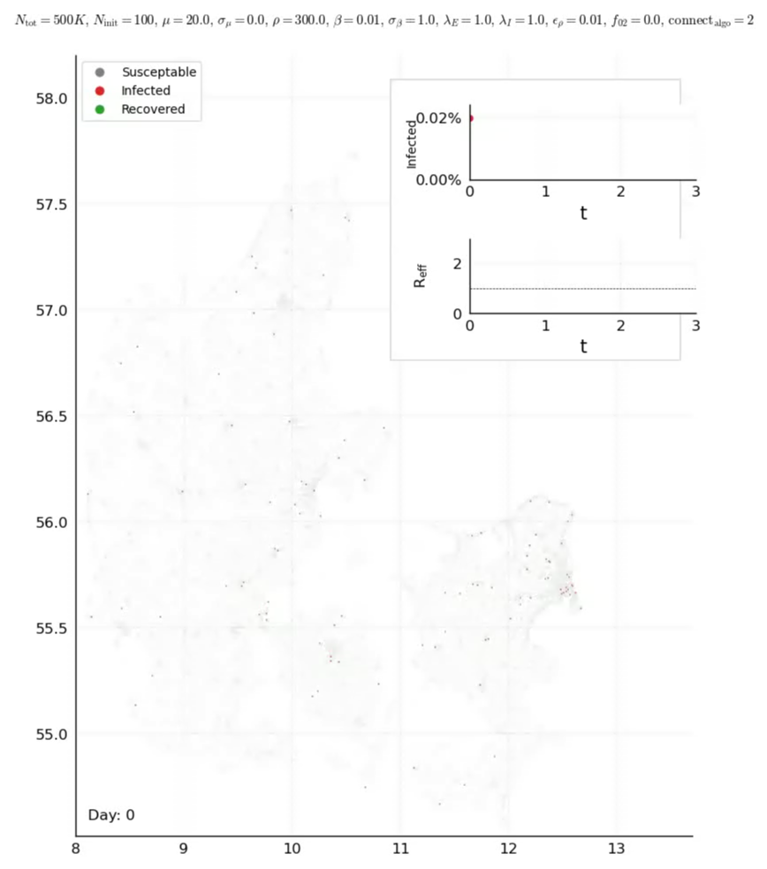
Spatial inhomogeneity visually
While the rates do not affect the overall outcome they do affect locally
Note: In ConnectAlgo2, there is no 1% connections distributed with no distance dependency. However, this should have little effect.

Slide 33
Early prediction error

Slide 34
Early prediction power
Given early data (before peak), how well does the mSEIR model predict peak
size (as simulated in an ABN), assuming we have perfect infection data?
We have tried to answer this, by conducting fits based on data from the blue
interval. Here, dark gray is the ABN model, while green are the mSEIR fits.

Slide 35
Practical implementations - not presented here

Slide 36
Age & Hospitalisation data
S
E1
E2
E3
E4
Age independent transitions
I1
I2
I3
I4
F
Age is introduced as a number between 0 and 10
In making connections, we use a connectivity matrix to calculate number of connections between age groups. We still use acceptance depending on weights and distance
R
H
ICU
D
https://www.fhi.no/en/id/infectious-diseases/coronavirus/coronavirus-modelling-at-the-niph-fhi/
Age dependent transitions

Slide 37
Fit with ABN model?
A core element in the practical implementation in the model is to include actual data of hospitalised patients.
To overcome this we estimate the effects of inhomogeneities, and include this as a multiplication function to the initial curve.
Another way to do this, is to run the ABN model multiple times to fit the data. To estimate the effects of political actions this is the way to proceed.

Slide 38
How to include actions?
Another core element in the practical implementation is the ability to predict the effect of political decisions.
With the current setup, we can at any time remove links between nodes.
This means that if we consider a specific type of job, we can estimate the effect of this by taking the number of nodes resembling the number of persons working in this section, and removing a given number of connections.
We also have the possibility to insert divide people in boxes, family, work and others. The given infection rates can then be grouped as well.

Slide 39
Questions from our side
What resources could be available for this? Computer memory might be a limiting factor.
What is the best way to move now?
What do you see as a timeline?

Slide 40
Conclusions
We have so far managed to produce a working Agent Based Network model, which can potentially incorporate a large number of effects and their interplay.
It is fast, reasonably realistic, and quite general.
Research results:
Investigating the effects of inhomogeneties, we have found that the distribution
of number of connections plays the most important role, followed by spatial
effects. Generally, the mSIER model gives too high prediction/result compared to the ABN, in some cases by a factor 2-3. Shedders essentially play no role.
Seemingly, there is basis to believe that herd immunity requires fewer infected.
Practical results:
The ABN model provides a way to include essentially all known effects.
This provides a tool for investigating the impact of (political) actions, provided accurate input data.
The animations give a further tool for investigating effects, and provide a way to communicate with.

Slide 41
Bonus Slides

Slide 42
Estimate of infected
Danish estimate (so far) is based on 12/1071 = 1.12 ± 0.32 (68%) infected persons.
This yields a 30% statistical uncertainty!
Consider the numbers from Stockholm Region:
Testing 1200/week for 8 weeks, the result was 7.3% (May 3rd in week 18, but estimate is then for week 15). Given about 9600 tested with 701 positives, this yields 7.30 ± 0.28 (68%) infected persons, thus 4% uncertainty!
With the number of deaths in Stockholm region at 1,855 people (by 19th of May),
compared to the Danish number around 530, this would indicate:
(7.30 ± 0.28) x (530 / 1855) = 2.09 ± 0.08
This calculation does not include test error rates nor precise timing corrections.
But my guess is that the real number is higher than 1.1%
Swedish study also shows age variations: 0-19: 4.7%, 20-64: 6.7%, 65-70: 2.7%.
Norway: 0.58% - 0.73%… how many did they test and when?

Slide 43
Philosophy of modelling
Overall philosophy:
Given “sparse” data, we wanted to build a simple model with few assumptions.
On model parameters:
We wanted to extract model values from fitting available (and unbiased) data.
Measuring development:
Fitting data to a model, we hope to get the best sensitivity to development.
Predictive power:
Provide predictions of number of hospitalisations, intensive care, respirators, etc.
both overall, but also for each region in Denmark, 1-2 weeks into the future.
Overall aim:
Contribute best we can with epidemic insights for planning/decision taking.

Slide 44
Peak ratio vs. N connections

Slide 45
Background and warranty
Limited warranty: We are NOT virology experts!
However, we are very accustomed to analysing complex data, and providing
insights and estimates with uncertainties. This is a first (very preliminary)
presentation of our attempt to model the Danish Corona epidemic.
Troels C. Petersen
Associate Prof. (NBI)
Worked with statistics, simulation, modelling, fits, etc. for many years (in particle physics).
Christian Michelsen
Ph.D. student (NBI)
Worked with statistics, simulation, and data analysis. Very capable with programming.
Mathias Heltberg
PostDoc (Paris/NBI)
Worked with statistics, simulation, networks, biocomplexity, etc.

Slide 46
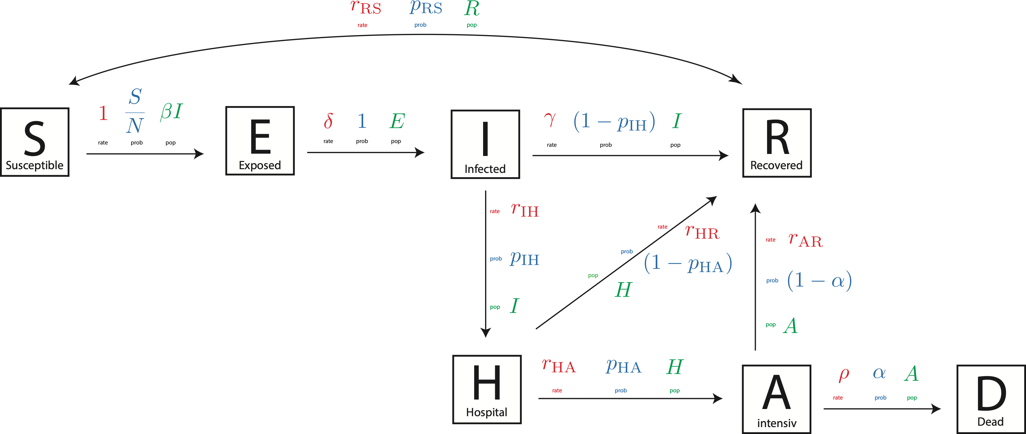
Improved model
This should contain “the full Monty”, which we in principle have ready! But…
…it requires better input on probabilities and distributions, than we have right
now!

